Slide 1



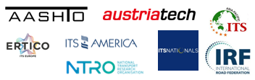

Contact Us / Stay Informed
its-australia.com.au
admin@its-australia.com.au
@ITS_AUSTRALIA

Slide 2
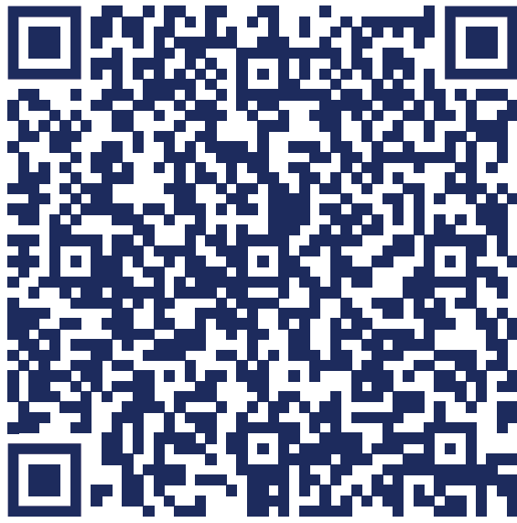








Call for abstracts
Call for Abstracts Now Open
Notes:
Co-hosted by ITS Australia and Transport Research Board (TRB)
World-Class Networking: Connect with international experts, policymakers, and industry leaders. this Symposium is particularly valuable to public sector professionals, engineering / consultancy firms, technology sector, academia, construction / finance industry
Melbourne Advantage: Experience a vibrant city with world-class connectivity and landmark freeway and tollway projects like Northeast Link and Westgate Tunnel.
Innovative & Visionary: Program designed to balance technical depth with forward-thinking leadership, inspiring collaboration and new ideas.
Integrated Program: Combines ISFO with ITS Australia Roads, Tolling & Tech Conference for enhanced learning and collaboration.
Executive Insights: High-level plenary sessions featuring senior leaders sharing strategic policy, investment, and mobility insights.
Showcase Your Work: Call for abstracts and special interest sessions invites contributions from industry,
government, and academia.
Abstract themes
Major Projects around the World
Advanced Traffic Management - Control Applications, Systems & Solutions
Safety for Users and On-Road Workers
Future Vehicles, Connectivity and Cooperative applications
Tolling & Transport Pricing
Road User Charging and Supporting Technologies
Cooperative Networks and Communication
Sustainable and Resilient Smart Infrastructure
Technology Innovations
Artificial Intelligence in Operations
Situational Awareness and Emerging Data
Telematics, Data Sharing and Security
Logistics and Freight
Major Events Coordination and Planning
International Perspectives & Case Studies
Roadworks and Event Traffic Management
Legal, Contracts, Procurement & Funding
Innovative Construction
Tunnel Technology

